Slide 1
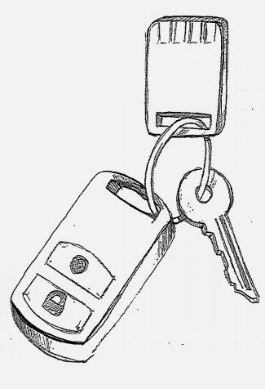
FIDO U2F Universal 2nd Factor
open standard strong authentication for the web

Slide 2
Presentation Structure
U2F Overview
Problem being solved
Value to the end user
Value to the Service Provider (RP)
Value to the device vendor, integration vendor
How U2F works
Protocol design considerations
U2F Spec layers
More use cases
Current Status
The larger view
UAF + U2F as a complementary whole
Working Group Logistics
Meeting schedule, communication etc

Slide 3
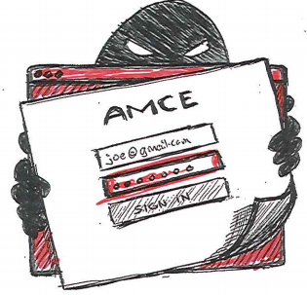
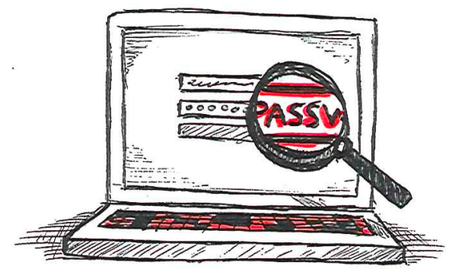
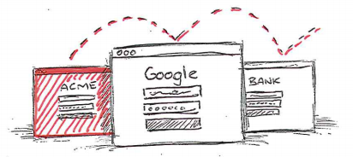
Web passwords are broken
REUSED
PHISHED
KEYLOGGED

Slide 4
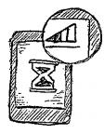
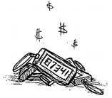
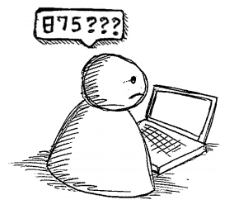
Today's solution: One time codes: SMS or Device
SMS USABILITY
DEVICE USABILITY
Coverage Issues - Delay - User Cost
One Per Site - Expensive - Fragile
USER EXPERIENCE
PHISHABLE
Users find it hard
German Police re: iTan: ".. we still lose money"

Slide 5
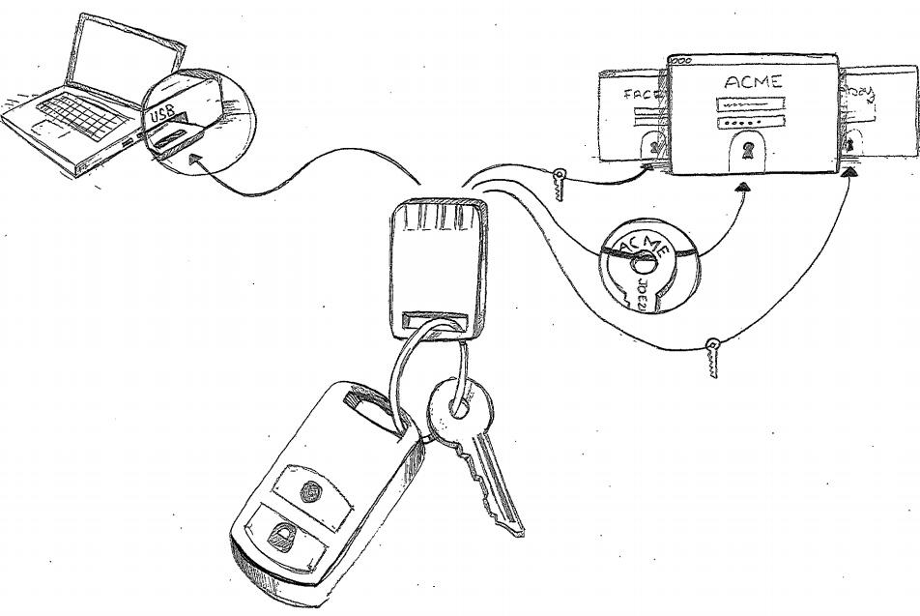
The U2F Solution: How it works
One device, many services
Easy: Press button
Safe: Un-phishable Security

Slide 6
Simple for Users
1
2
3
Userid & Password
Present U2F device.
Successful Sign in
Presenting a U2F device over various transports:
For USB U2F device = Insert and press button
For NFC U2F device = tap
For Bluetooth U2F device = press button
For built-in onboard U2F device = button or equiv. UI gesture

Slide 7
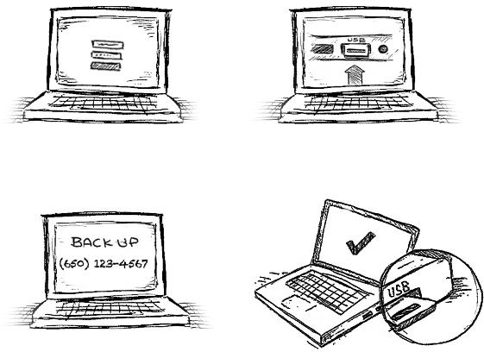
User self-registration
1
Userid & Password
2
Present U2F device
3
Backup Options
4
Registration Done

Slide 8
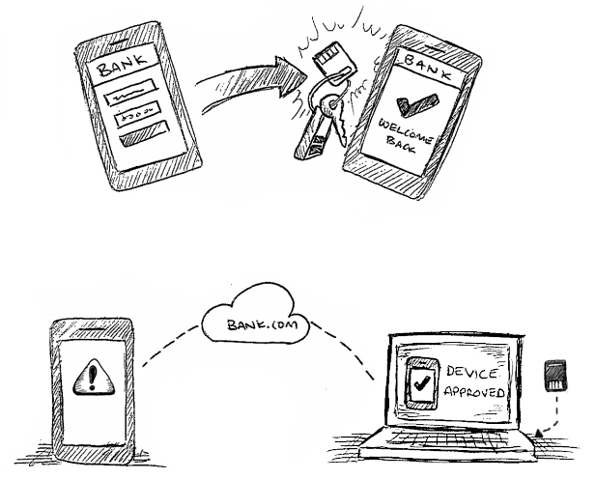
Usage on Mobiles
Tomorrow
Use NFC, Bluetooth or on-board U2F capability.
Today
Use your computer to bless your mobile (one time action)

Slide 9
Small, Reliable, Secure
Battery-less options
Robust
Strong Client Side Security

Slide 10
U2F Protocol
Core idea: Standard public key cryptography:
User's device mints new key pair, gives public key to server
Server asks user's device to sign data to verify the user.
One device, many services, "bring your own device" enabled
Lots of refinement for this to be consumer facing:
Privacy: Site Specific Keys, No unique ID per device
Security: No phishing, man-in-the-middles
Trust: Verify who made the device
Pragmatics: Affordable today, ride hardware cost curve down
Speed for user: Fast crypto in device (Elliptic Curve)
Think "Smartcard re-imagined for modern consumer web"

Slide 11
Under the hood
U2F spec layers
Common Crypto Layer Spec
Transport Layer Specs: User device <-> u2f device
First transport spec: Driverless USB
Immediate followons: NFC, Bluetooth, on-board
Direct Access from Browser:
No client middleware to install
Simple Javascript API: 'Create Key Pair' and 'Sign'
Not just tied to login! Use anytime you want to strongly verify user.
Following phase: Native OS APIs
UI seen by user completely under server control
Easy server side integration

Slide 12
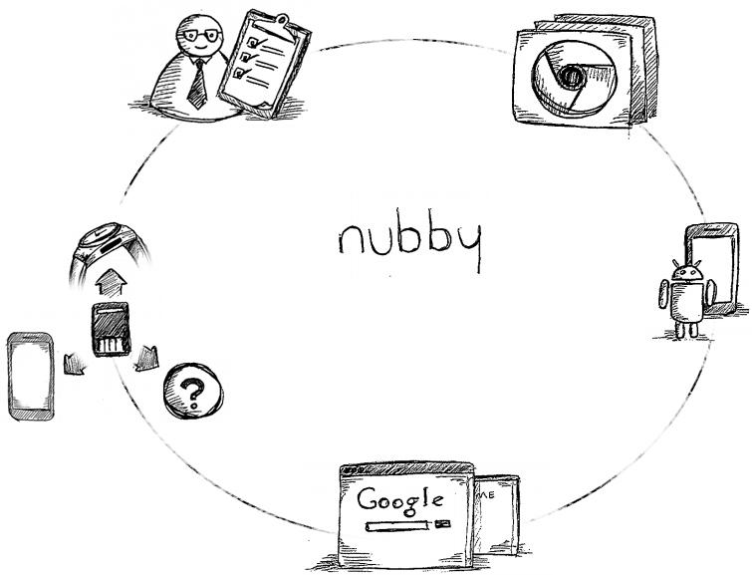
Open Ecosystem
CONSULTING
BROWSER SUPPORT
OPEN
FIDO ALLIANCEU2F WORKING GROUP
MOBILE OS SUPPORT
MANY DEVICES & FORM FACTORS
ADOPTION

Slide 13
U2F: Univ. 2nd Factor: In a nutshell
User has 2nd factor strong auth. device
Works with any service which supports it
Mental model "Like a key on your chain, a card in your wallet"
For the user: Easy Secure Login
One device, Many services
Simple UX - press button or tap, no software install
Passwords can be made simple -- 4 digit pins like ATM?
For the web site (RP): Open Strong Security
Open: Not proprietary, multiple vendors, no central service required
Self provisioned: No pre-seeding req, "Bring your own token" possible
Strong Security: Non-Phishable, Blocks most practical MITMs
Strong Privacy: One site cannot use credential given to another

Slide 14
Other usage models beyond "One key you carry"
Token for home machine
husband and wife share
husband for Sites A and B, wife for Sites C and D
One token at home, one token at work
User provisions both for paypal, can pay from either place
One token plugged in at home, one token to carry
Convenience, home computer always ready to go
One (tiny) token plugged permanently into work laptop
Laptop becomes the 2nd factor (maybe built into next-gen laptops?)
Husband/wife, separate tokens,
Each activates own key, protocol has no problem with multiple keys
One account, multiple users, each with own token
Small business users share an account with strong auth
Account lockdown to a single device
Only one token, permanently with office machine
Same token for work account and personal account
Work (= enterprise) leverages user's "bring your own token"
Different token for work account and personal account
If enterprise doesn't like self-provision, can ship pre-provisioned token

Slide 15
Current U2F Status
Targeting Review Draft Spec: Dec 2013
Crypto Layer Spec
Transport layer Spec: USB
Ongoing work on on other transports
NFC, Bluetooth LE, Onboard on Android.
Working-Draft Protocol Version implemented
Multiple interoperable servers from members
One token implementation availablle
Other token implementations actively planned
Google deployed in-house for employees

Slide 16
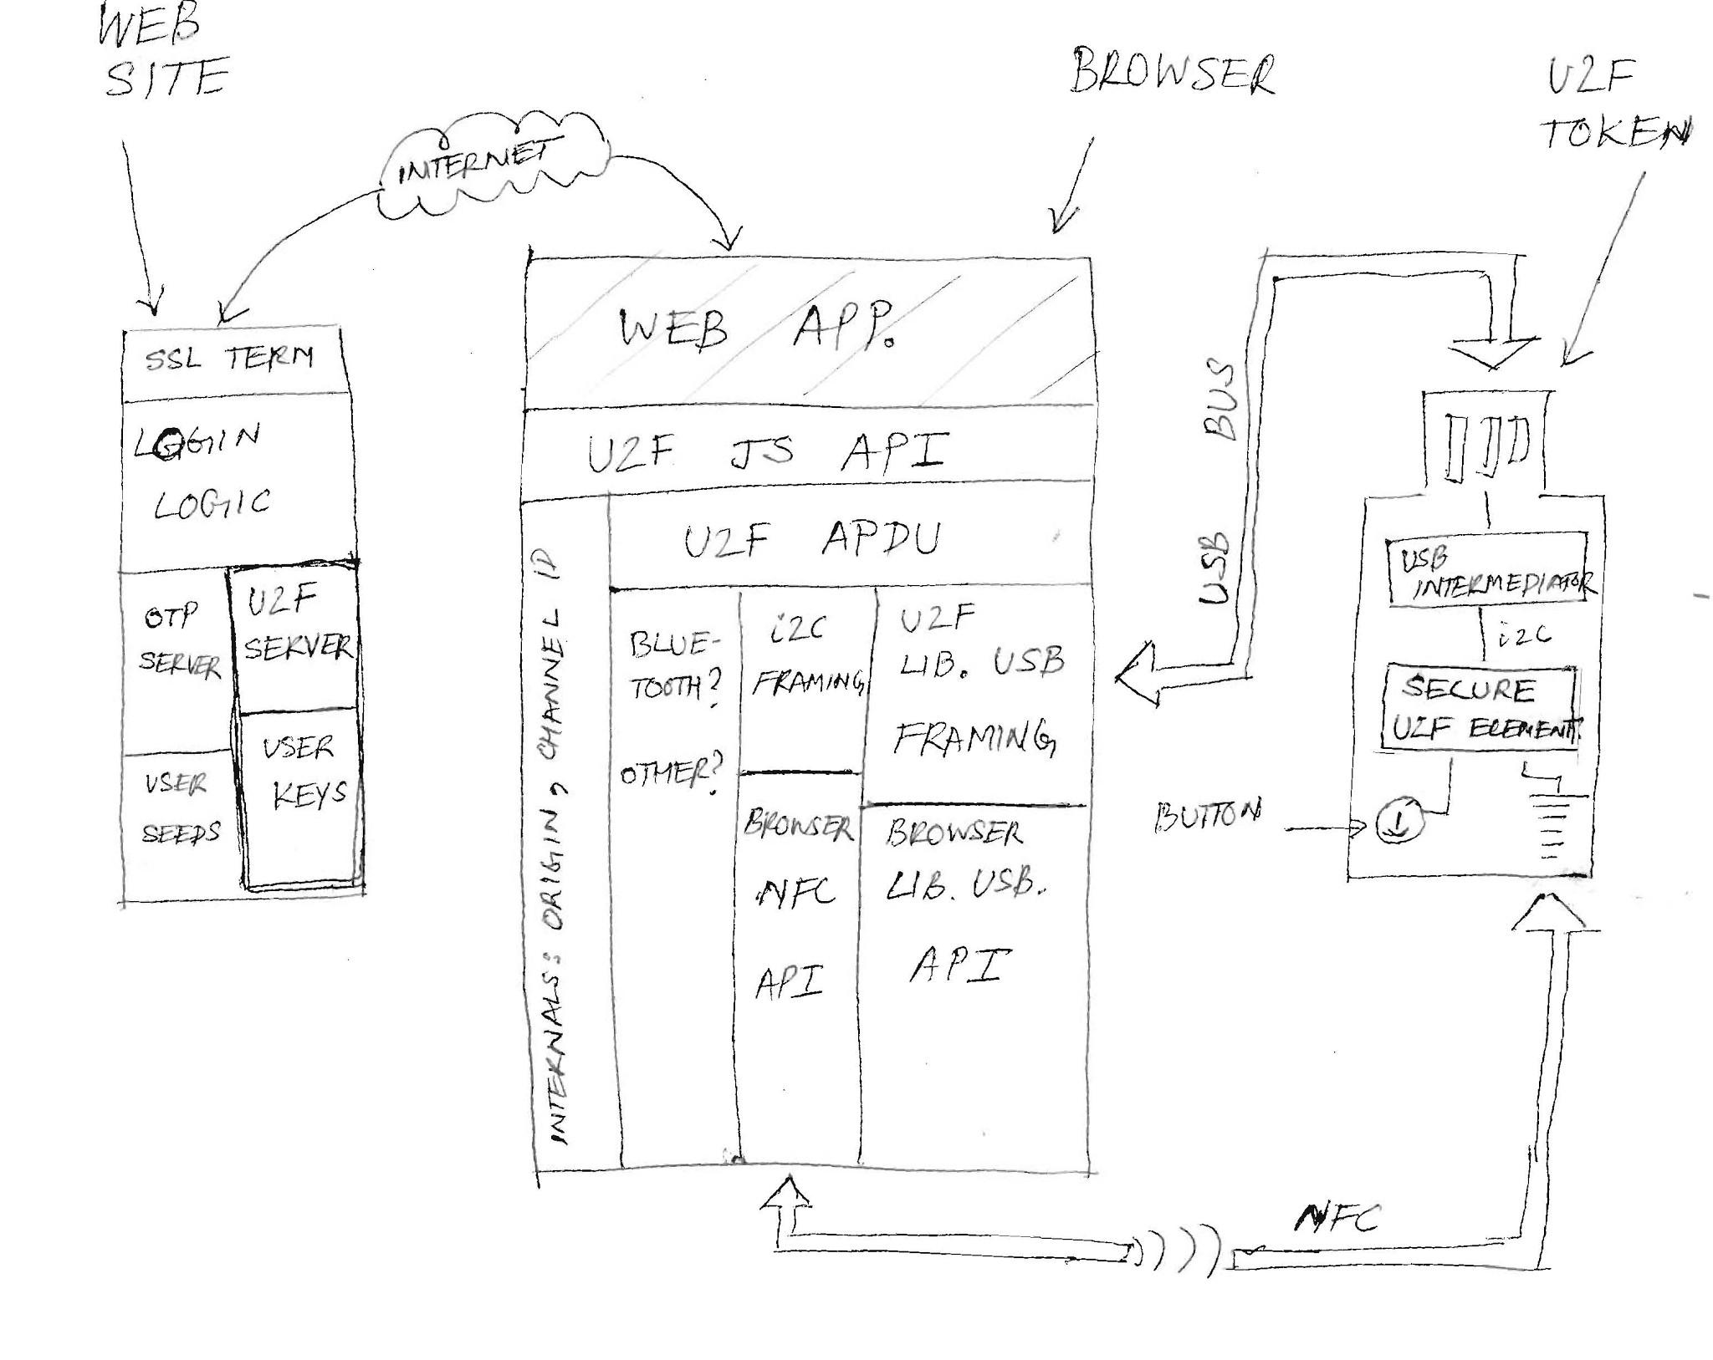
U2F Schematic

Slide 17
How they fit: UAF + U2F
UAF = Universal Authentication Framework
Larger View, password less, local device auth for sign = OSTP
U2F = Universal 2nd Factor
Critical bridge to future, "classic" 2-factor, incremental change for RP
Service (RP) password still present, but can be simple (4 digit PIN?)
How do they fit together? Message to Service Provider (RP):
At registration: Discover user has FIDO UAF enabled device?
Register that for passwordless experience
Else offer user FIDO U2F token in a browser.
Self-register for simple password 2 factor experience
At login: User has FIDO UAF enabled device + UAF registration?
Exercise UAF experience
Else user has U2F registration?
Exerciser U2F login experience.
Some RPs may want to offer only UAF, some only U2F
That's no problem, FIDO is all about the right choice for RP and user
Note that they can start offering "other" flavor later seamlessly.
Backstory: Server talking both protocols possible today
Harmonization is important, but can be medium term.

Slide 18
Working Group Logistics
Weekly Thursday 1030am-1130am Pacfic
Primary meeting by telephone bridge
Active ongoing discussion by email

